Slide 1
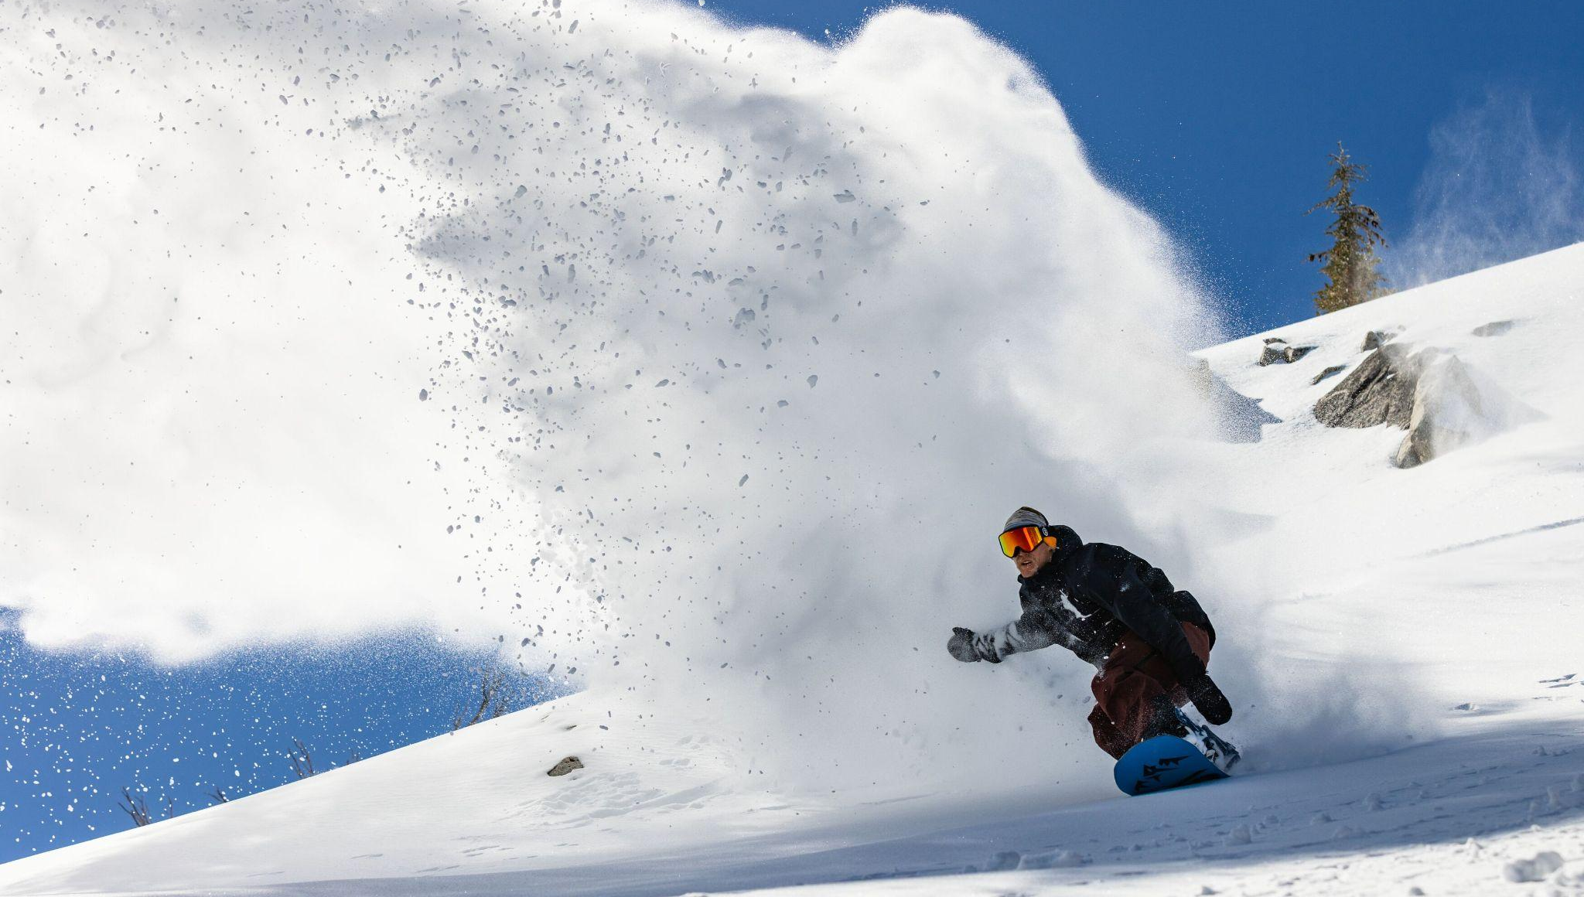

PRODUCT UPLOAD
Guidelines

Slide 2
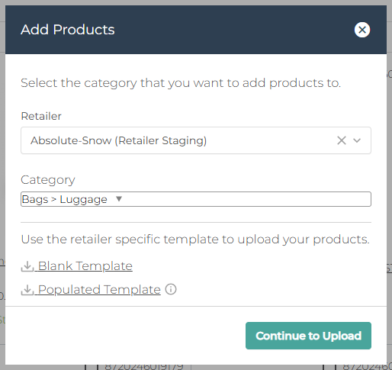
PRODUCT UPLOAD STEPS
Inside the Dsco Platform vendor portal navigate to Workflows > Products
Top right button [Add Products]
Search and select the relevant category.
If none exist then use Generic, decide whether the product is gendered or not to determine which category to use.
Download the template
Follow instructions on the Excel file, when complete repeat the previous steps and instead of downloading the template > Continue to Upload
Upload sheet

Slide 3
REFERENCE GUIDES
In order to keep your products looking as streamlined as possible on our website, please familiarise yourself with our standardisation documents below.
General Rules
Size, Title & Colour Standardisation
Image Guidelines

Slide 4
The following slides highlight why we ask for certain attributes and demonstrate why it is beneficial for you to fill out all available fields even if they are marked as Recommended or Optional.
They also show the difference between similar fields and where the information ends up.
If you have any additional questions, do not hesitate to reach out.

Slide 5
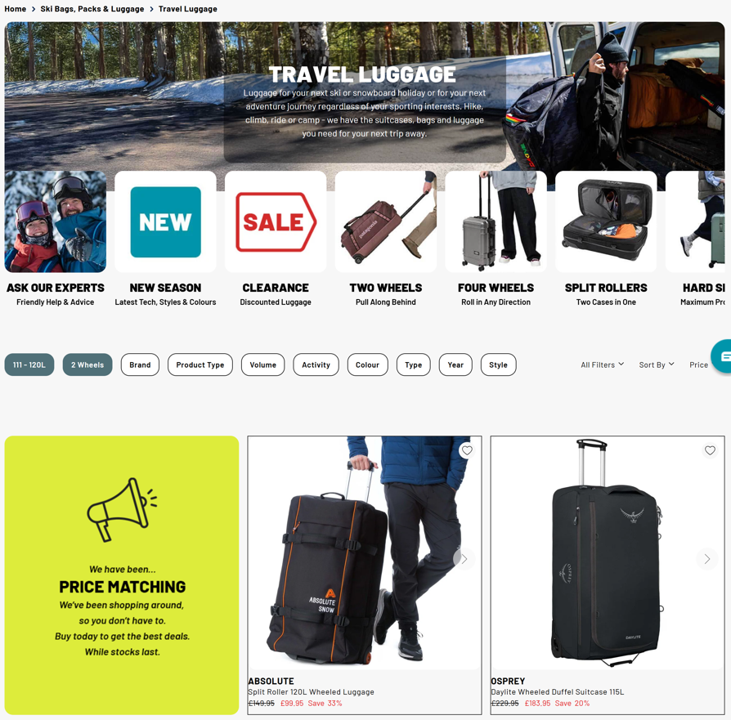
PRODUCT LIST PAGE (PLP)
We use attributes to create PLP pages. For example, this link would take you to all 2 wheeled luggage, if your product was missing the 2 wheel tag, then it will not show on that page.
As above, failure to fill out recommended fields may omit your product from being captured within our filters.
We have marked required fields for basic navigation but the onus is on you to give us more detailed information, often from dropdown options, within the recommended fields.

Slide 6
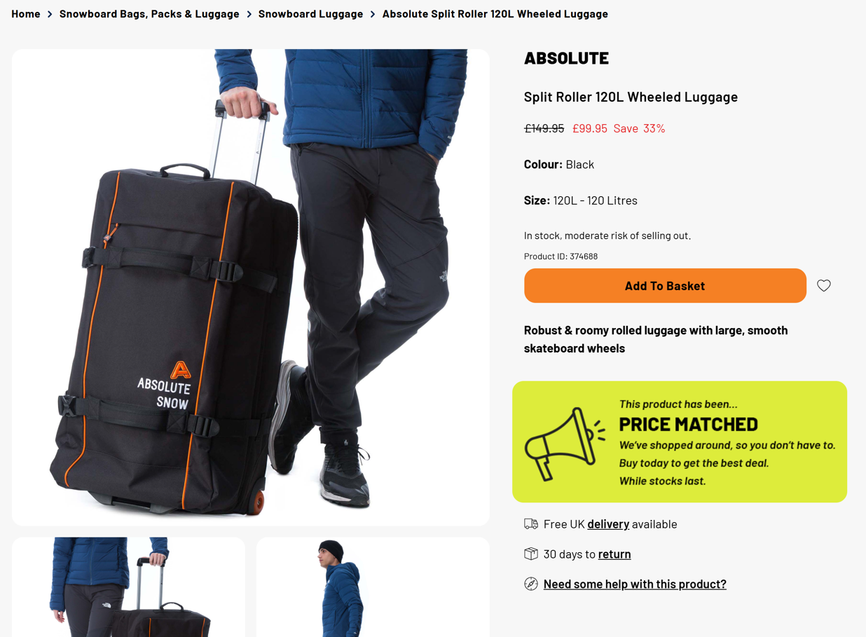
PRODUCT DISPLAY PAGE
This auto splits off the brand name, you are required to include brand in the Title field eg: Absolute Split Roller 120L Wheeled Luggage
Size Exact: 120L
Size Description: 120 Litres
Short Description shows here
Possible to highlight promotions
https://www.absolute-snow.co.uk/absolute-split-roller-120l-wheeled-luggage?v=374688

Slide 7
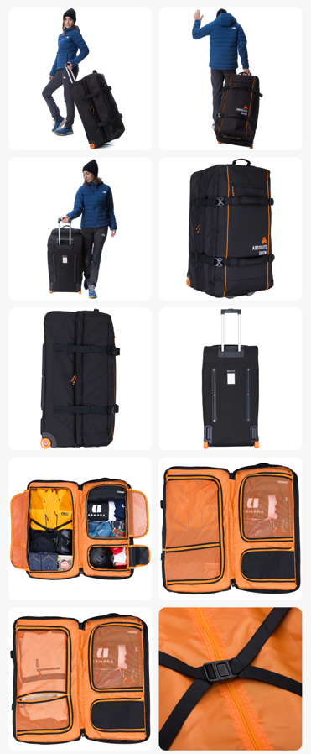
PRODUCT DISPLAY PAGE
Additional images show the product from all angles and includes detailed shots.
White Backgrounds
2000x2000px
See below for more specific guidelines
Photo Preparation Best Practices

Slide 8
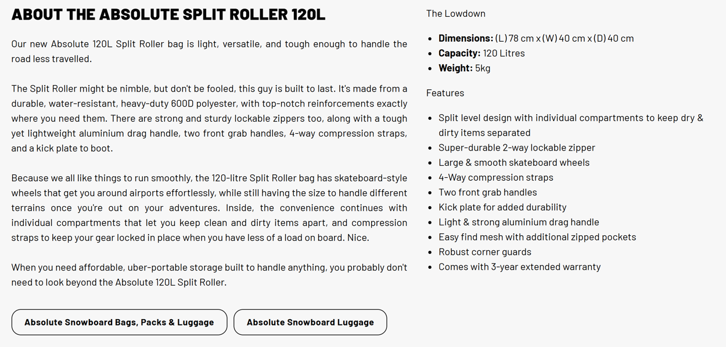
PRODUCT DISPLAY PAGE
Brand: Absolute
Model: Split Roller 120L
The Lowdown is auto populated based on attributes, the more you answer within the product set up sheet, the more complete the product profile will look.
It will add consistency with our own products and make it easier for the customer to compare their options.
This bit is the Product Features on the upload sheet as: USP title and USP description. See next slide for details.
Long Description Ideally, this would be unique content eg. not simply copy pasted from an existing site but we understand time constraints may make that impossible.

Slide 9
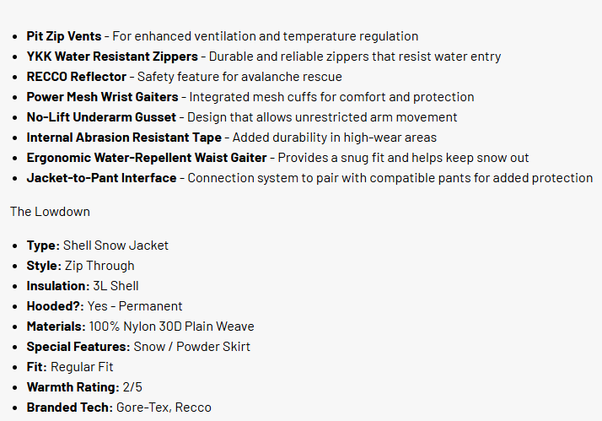
PRODUCT DISPLAY PAGE
Product Features typically show on top and The Lowdown is on the bottom so this is a more up to date visual of how your listing will look on the site.
USP Title 1: Pit Zip Vents
USP Description 1: For enhanced ventilation and temperature regulation
There is no need to format anything, that gets done in our PIM so just enter plain text and the bullets and dashes will populate themselves.

