Slide 1
Drop Ship Brand Requirements

Slide 2
Brand Partner Requirements
Contact Information Sheet to Onboarding Team
Join a Monthly OnBoarding Call
Complete Rithum Set Up via Wizard tool
Load UPCS to InterTrade
Complete IE Template & Submit VPI 6+ wks prior to launch
Use NMG Packing List Format
Inventory must update once a day, ideally 3x a day
Ship via our 3rd Party FedEx Account
Ship / Cancel Orders within 24 HRs of transmission
US Based Distribution Center
Additional information can be found on the Rithum NMG Landing Page https://support.dsco.io/hc/en-us/articles/360004876131-Neiman-Marcus-Documentation

Slide 3
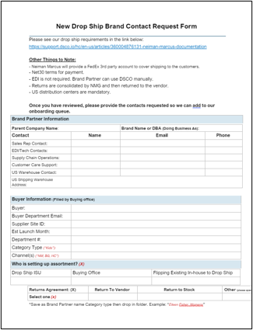
Brand Partner Contact Info
Things to Note:
Neiman Marcus will provide a FedEx 3rd party account to cover the shipping to the customers.
Net 30 terms for payment
EDI is not required – Vendors can use Rithum manually
Returns are consolidated and returned to vendor
US distribution centers are mandatory
Brand Contacts:
Sales Rep
EDI/Tech Contacts
Supply Chain Operations
Customer Care / Consumer Support
Buying Office Info:
Buyer Department Email
Est Launch Month
Department #
Additional information can be found on the Rithum NMG Landing Page https://support.dsco.io/hc/en-us/articles/360004876131-Neiman-Marcus-Documentation

